Slide 1








HOME
ABOUT
SERVICE
CONTACT
Building
Basic Calculator
By Ajay Kumar Sahu
A PROJECT BY NEXTHIKES IT SOLUTIONS
Python+Tkinter GUI

Slide 2



HOME
ABOUT
SERVICE
CONTACT
TABLE OF CONTENTS
01.
02.
03.
INTRODUCTION
FEATURE OVERVIEW
VISUALS
Why calculator matter: quick, reusable, user-friendly tools
Scientific Calculator, Currency Converter, Ruler, Chart, Thermometer, Backspace & Theme Toggle
Currency, Length, Rates and Temperature

Slide 3
HOME
ABOUT
SERVICE
CONTACT
TABLE OF CONTENTS
04.
05.
06.
ARCHITECTURE DIAGRAM
CODE HIGHLIGHTS
LEARNING OUTCOMES
Multimode Calculator, Notebook(ttk.Notebook), Calculator Tab, Currency Tab, Length Tab, Rates Tab, Temperature Tab & Entry Point
Display Setup, Evaluation and Button Creation
Core Python Programming, Tkinter GUI Development, Using VS Code, Github for Version Control, Application Development Workflow

Slide 4
HOME
ABOUT
SERVICE
CONTACT
TABLE OF CONTENTS
07.
08.
09.
CHALLENGES & SOLUTIONS
FUTURE ENHANCEMENTS
LEARNING OUTCOMES
Handling Invalid Input, Error Handling, GUI Layout, Tkinter Grid System, Reusability and Modular Functions
AI Mode, Graph Plotting, Symbolic Calculus, Real-Time Currency API Integration
Core Python Programming, Tkinter GUI Development, Using VS Code, Github for Version Control, Application Development Workflow

Slide 5
HOME
ABOUT
SERVICE
CONTACT
TABLE OF CONTENTS
10.
11.
CONCLUSION
SUMMARY
How python + Tkinter can build practical, reusable GUI applications
Multi-Functional Calculator Application Using Python's Tkinter Library

Slide 6





HOME
ABOUT
SERVICE
CONTACT
INTRODUCTION
Welcome to showcase of Building a Scientific GUI Calculator using Python. A scientific calculator is a type of electronic calculator, usually but not always handheld, designed to calculate problems in science, engineering, and mathematics. The python calculator has implemented using tkinter to make the calculation of mathematical functions easier. The application consists of scientific and standard functions. The standard is used to solve scientific notation type math functions like sin, cos, tan, log etc. This internship project demonstrates the power of Python in creating a sophisticated GUI for a calculator. Join me as I delve into the technical details and design principles behind this innovative project.

Slide 7


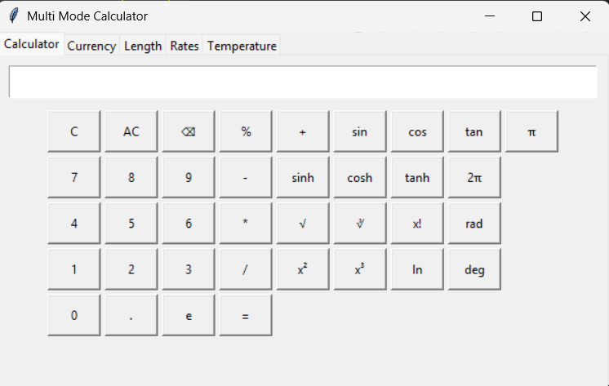
HOME
ABOUT
SERVICE
CONTACT
WELCOME TO PRESENTATION
Multimode GUI Calculator:

Slide 8






HOME
ABOUT
SERVICE
CONTACT
FEATURE OVERVIEW
SCIENTIFIC CALCULATOR
CURRENCY CONVERTER
Support basic arithmetic(+,-,×,÷).
Trigonometric functions (sin,cos,tan,sinh,cosh,tanh).
Factorial: x!
Powers: x²,x³,and custom exponents
√Root: square root(√),cube root(∛)
Extra: radians ↔ degree conversion, π and e constants
Amount (e.g., 100)
Rate (e.g., 1 USD= 83 INR
Example demo: 100 USD at 83 INR= 8300 INR
RULER→”Length Converter”
CHART→”Rates Calculator”
Converts meters→ feet quickly and accurately
Formula used: feet= meters X 3.28
Calculates Simple Interest(SI) based on user inputs
Formula used: SI=P×R×T / 100

Slide 9
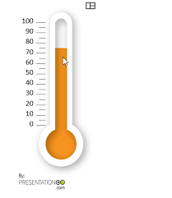

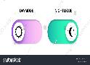
HOME
ABOUT
SERVICE
CONTACT
FEATURE OVERVIEW
THERMOMETER
BACKSPACE
Converts Celsius→Fahrenheit instantly
Input field: enter value in Celcius
Formula used: F=(9/5×C)+32
Allow users to delete the last character in the display.
Improves usability compared to only having “Clear” or “All Clear”
Prevents frustration when typing long expressions- no need to start over
THEME TOGGLE(LIGHT/DARK)
Allows users to switch between light and dark themes
Improves readability in different environments.

Slide 10
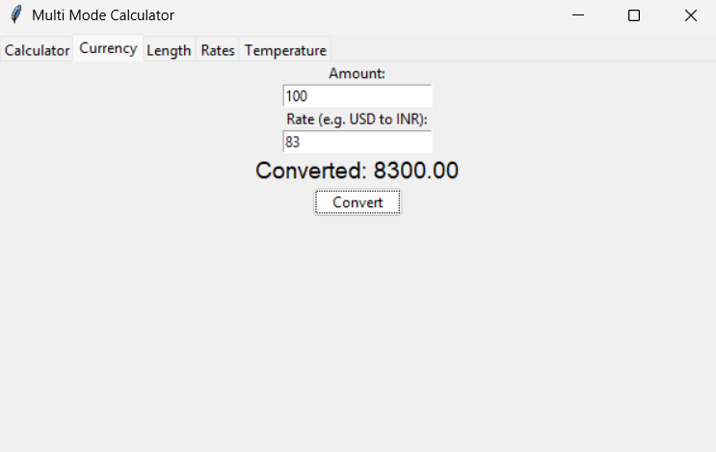
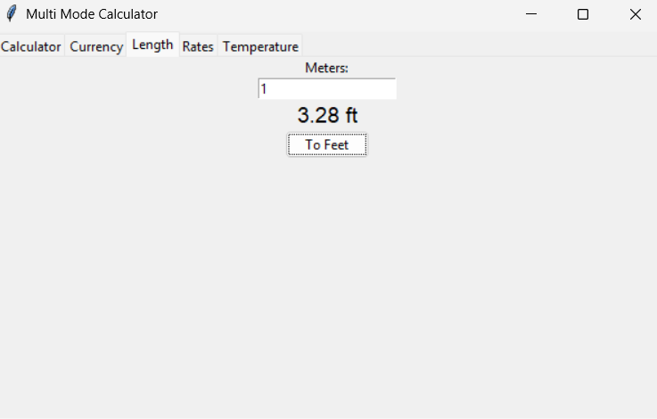
HOME
ABOUT
SERVICE
CONTACT
VISUALS
Currency:
Length:

Slide 11
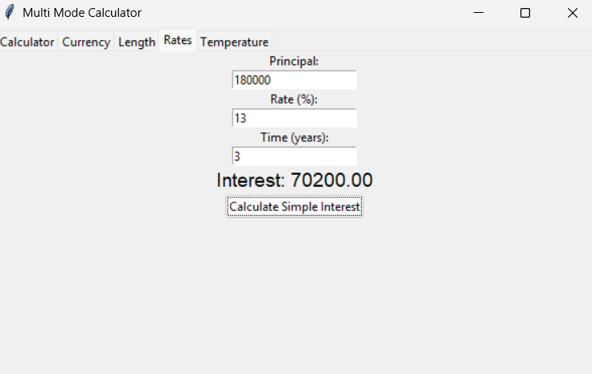
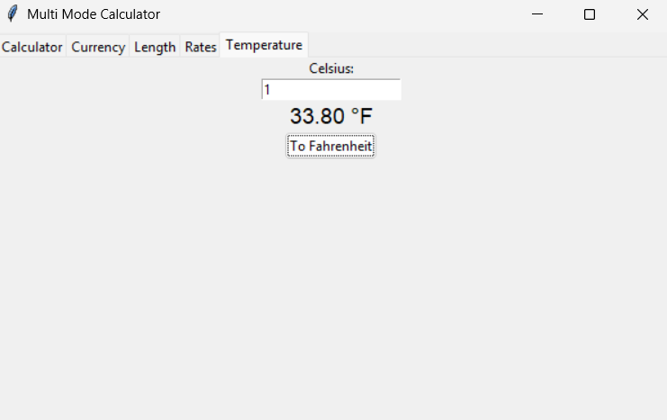
HOME
ABOUT
SERVICE
CONTACT
VISUALS
Rates:
Temperature:

Slide 12
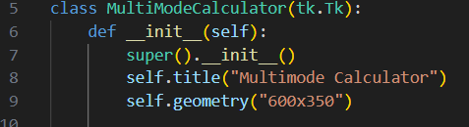
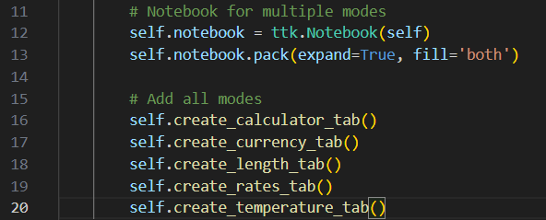

HOME
ABOUT
SERVICE
CONTACT
ARCHITECTURE DIAGRAM
Multimode Calculator:
Notebook (ttk.Notebook):

Slide 13
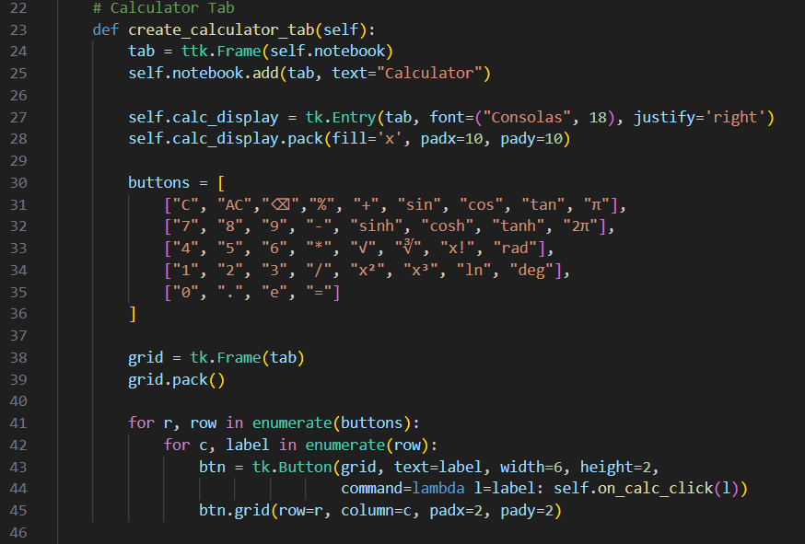
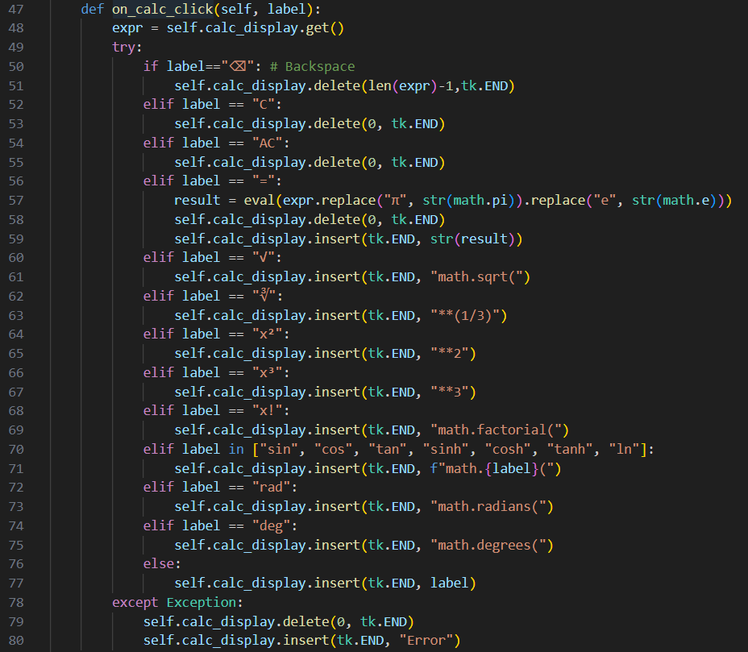
HOME
ABOUT
SERVICE
CONTACT
ARCHITECTURE DIAGRAM
Calculator Tab 1:
Calculator Tab 2:

Slide 14
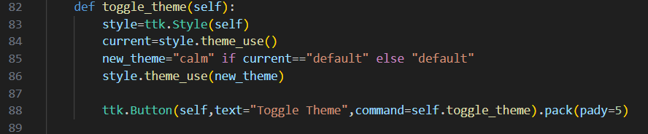
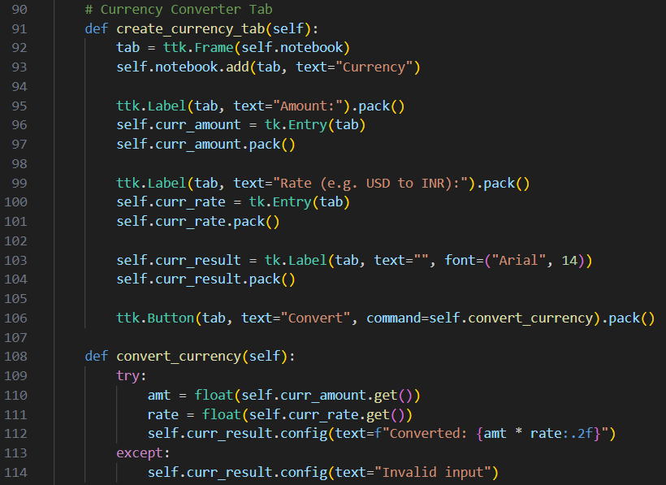
HOME
ABOUT
SERVICE
CONTACT
ARCHITECTURE DIAGRAM
Calculator Tab 3:
Currency Tab:

Slide 15
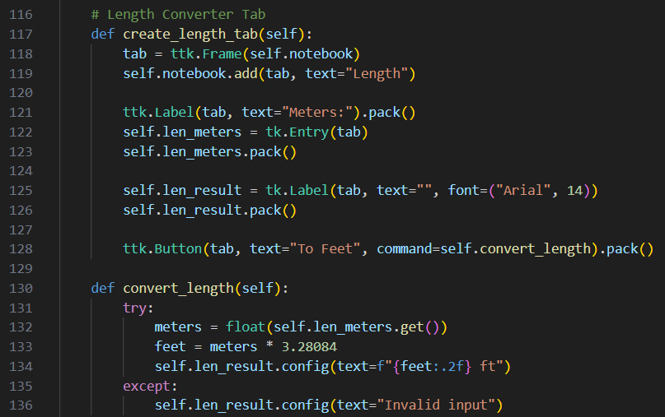
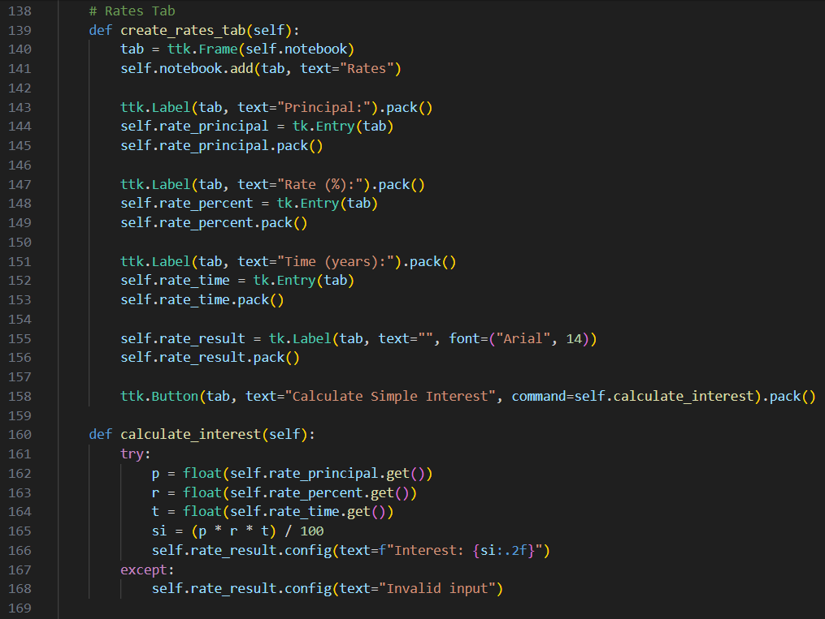
HOME
ABOUT
SERVICE
CONTACT
ARCHITECTURE DIAGRAM
Length Tab:
Rates Tab:

Slide 16
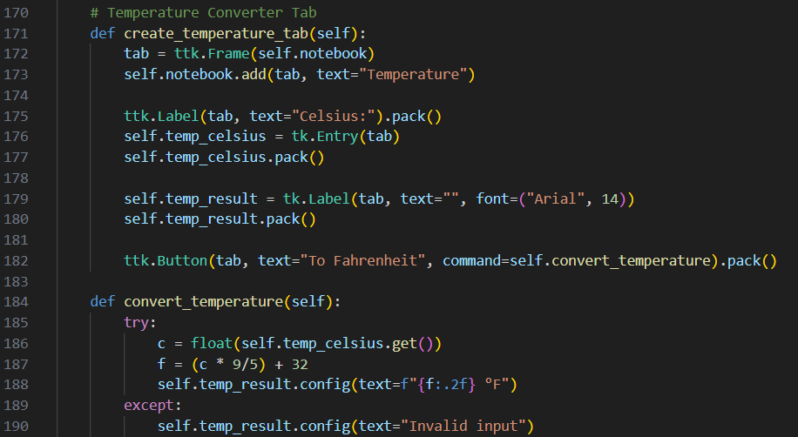
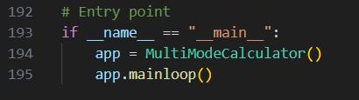
HOME
ABOUT
SERVICE
CONTACT
ARCHITECTURE DIAGRAM
Temperature Tab:
Entry Point:

Slide 17






HOME
ABOUT
SERVICE
CONTACT
DISPLAY SETUP
🖥️
self.calc_display = tk.Entry(tab, font=("Consolas", 18), justify='right')
CODE HIGHLIGHTS
EVALUATION
🟰
result = eval(expr.replace("π", str(math.pi)).replace("e", str(math.e)))
🔘
BUTTON CREATION
tk.Button(grid, text="7", command=lambda: self.on_calc_click("7"))

Slide 18



HOME
ABOUT
SERVICE
CONTACT
LEARNING OUTCOMES
Core Python Programming
💡
Tkinter GUI Development
strengthened coding fundamentals
🐍
🖼️
built interactive, user‑friendly interfaces
ETHICS IN PYTHON
GitHub for Version Control
Using VS Code
💻
🐱
efficient coding and debugging environment
collaborative development and version tracking
🔄
Application Development Workflow
end‑to‑end project building experience

Slide 19


HOME
ABOUT
SERVICE
CONTACT
CHALLENGES & SOLUTIONS
CHALLENGE:
SOLUTION:
Handling invalid input
error handling
CHALLENGE:
SOLUTION:
GUI layout
Tkinter grid system

Slide 20
HOME
ABOUT
SERVICE
CONTACT
CHALLENGES & SOLUTIONS
CHALLENGE:
SOLUTION:
Reusability
modular functions

Slide 21



HOME
ABOUT
SERVICE
CONTACT
FUTURE ENHANCEMENTS
🧠
AI MODE:
Natural language queries
📊
GRAPH PLOTTING:
Matplotlib integration

Slide 22

HOME
ABOUT
SERVICE
CONTACT
FUTURE ENHANCEMENTS
SYMBOLIC CALCULUS:
Derivatives, integrals
REAL-TIME CURRENCY API INTEGRATION
🌍
Allow the app(like calculator) to fetch the latest exchange rates from a trusted source- such as Google

Slide 23



HOME
ABOUT
SERVICE
CONTACT
CONCLUSION
“This project demonstrates how Python + Tkinter can build practical, reusable GUI applications.”
- Extensible, professional, user‑friendly

Slide 24


HOME
ABOUT
SERVICE
CONTACT
SUMMARY
This project presents the development of a versatile, multi-functional calculator application using Python's Tkinter library. Unlike standard calculators, this "Multimode" version allows users to switch between different operational interfaces, such as:
Standard Mode: Basic arithmetic (addition, subtraction, multiplication, division).
Scientific Mode: Advanced functions including square roots, factorials, and trigonometric calculations.
Specialty Modes: Features such as area/geometry calculations or unit conversions.

Slide 25

THANK YOU!

